Slide 1

Dr. Gajanan T. Hivale

Slide 2
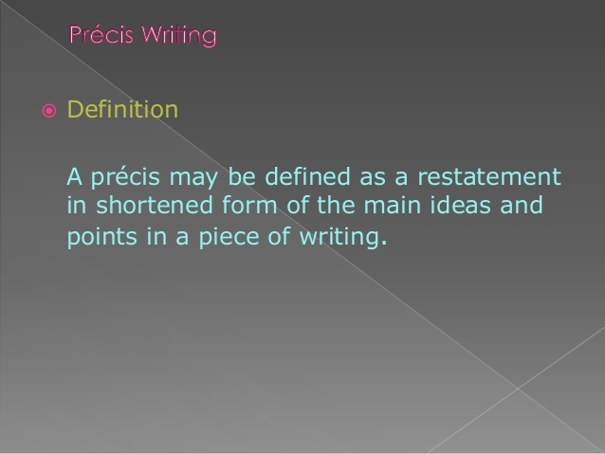

Slide 3
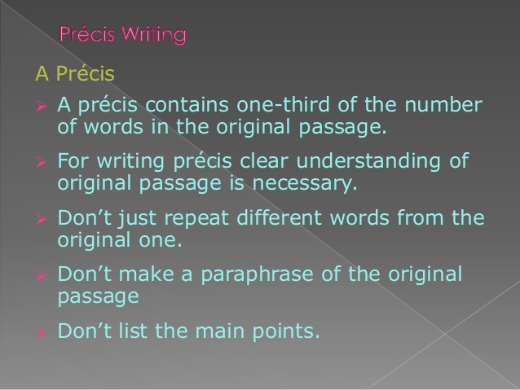

Slide 4
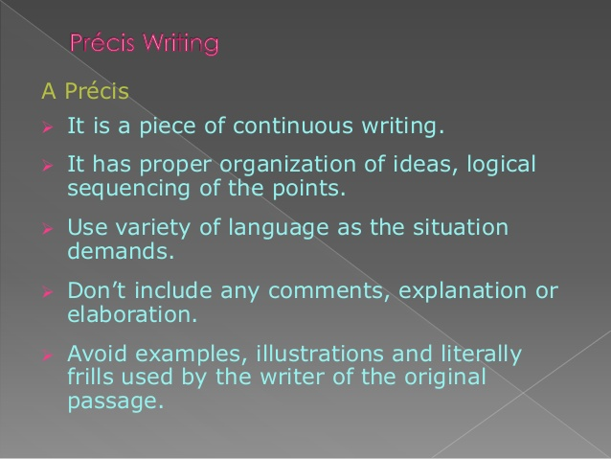

Slide 5
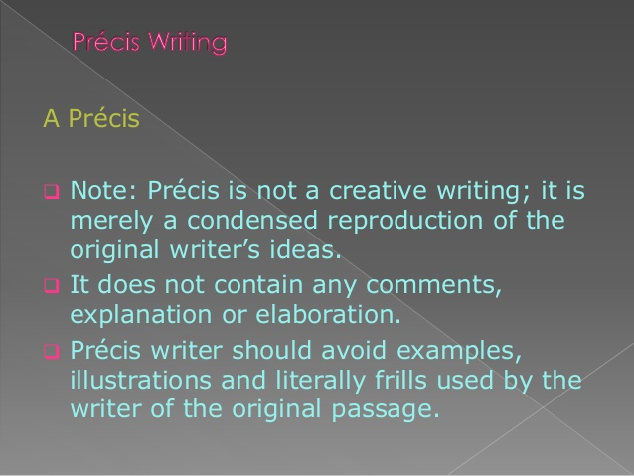

Slide 6
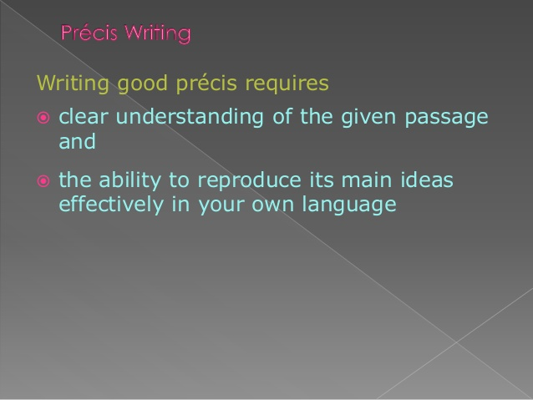

Slide 7
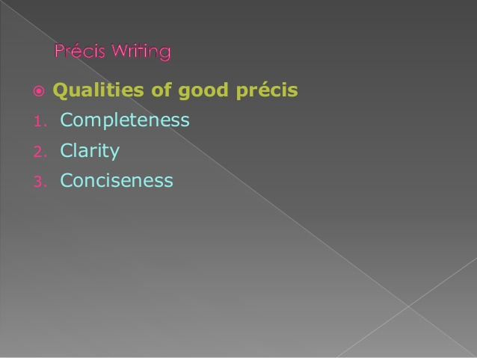

Slide 8
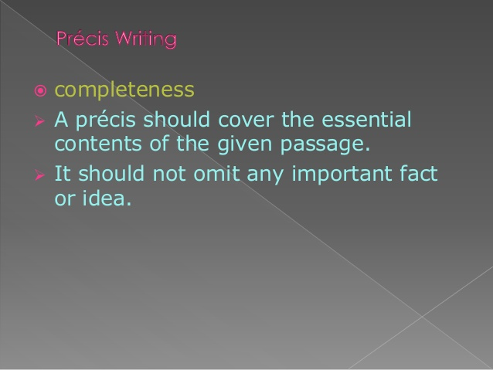

Slide 9
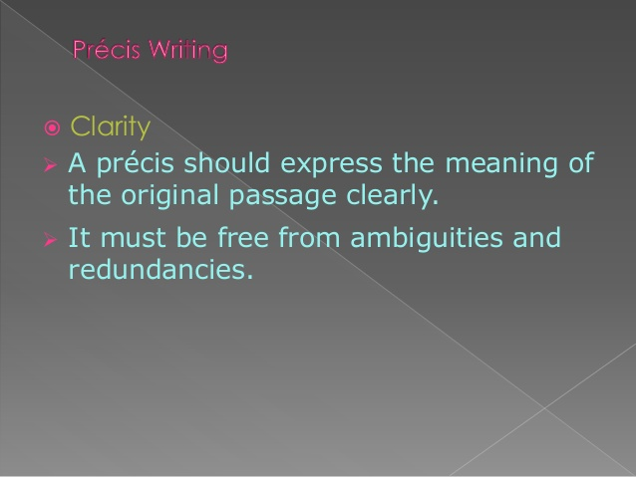

Slide 10
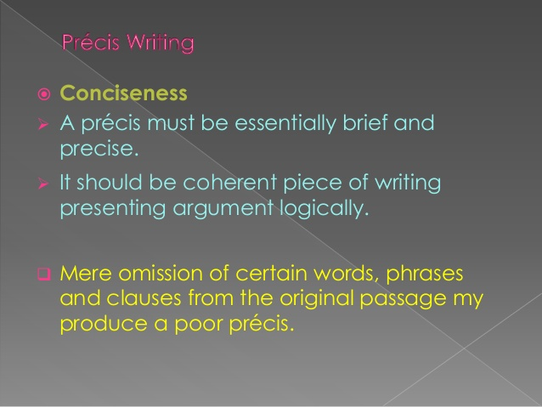

Slide 11
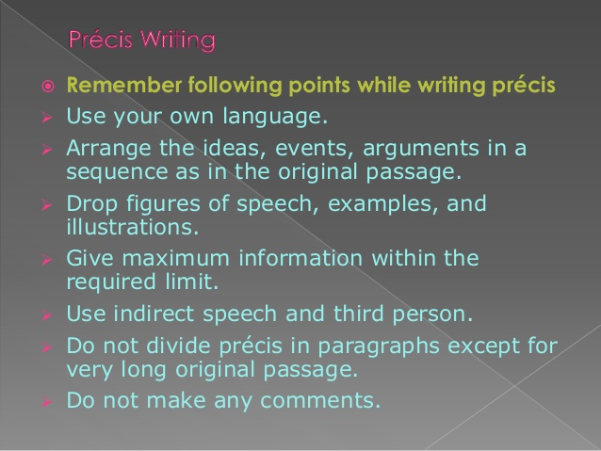

Slide 12
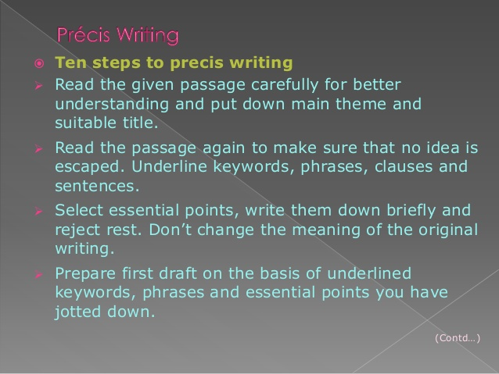

Slide 13
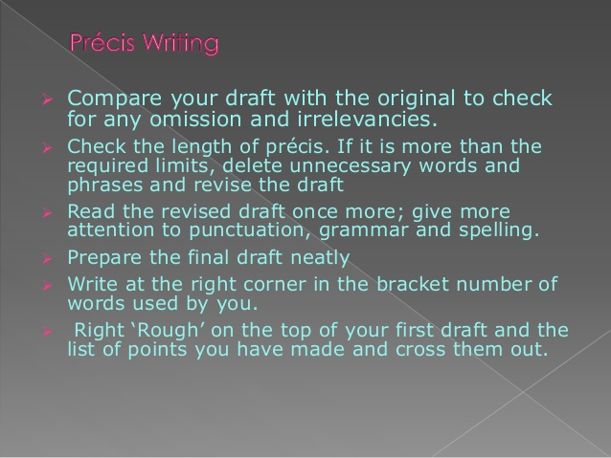

Slide 14
Comprehension Passage:
Everybody knows what a “good” man means and how he should be. Our definition of a good man is the one who does not smoke, or drink or avoids the usage of bad language. A good man is ideally expected to converse in front of men as he would in front of women. He is also expected to attend the Church regularly and have correct opinions on all subjects. He has a wholesome horror of wrong-doing and realizes that it is our painful duty to reprimand sin. He is not anticipated to have wrong thinking and has the authority to protect the young. His duties are not just restricted to the professional front but also needs to spend quality time doing good deeds. He must be patriotic and a keen believer of military training, he should promote industry, must be sober and have virtue among wage earners and their children. He must be a role model for all and it is expected that he leads a way which the younger generation would willingly follow. Above all, of course, his “morals” in the narrow sense must be admirable.
Precis Writing:
Title: Attributes of a Good Man
The characteristics of a good man are known and he is expected to be religiously profound, must not smoke, drink or use bad language. His behaviour must be the same for all genders and he is expected to be a role model for the young ones. He must know his duties and avoid taking up the path of sin. He must be good not only in the professional space but also help people in need. He must be someone who can be admired and is praiseworthy.

Slide 15


